Slide 1
COMPANY PROFILE
S&S

Slide 2

Solve & Solution Pvt Ltd
Your complete business solution provider
Solve and Solution Pvt. Ltd.

Slide 3
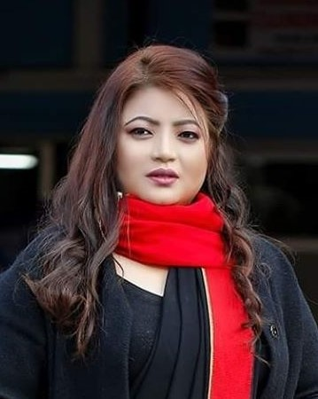
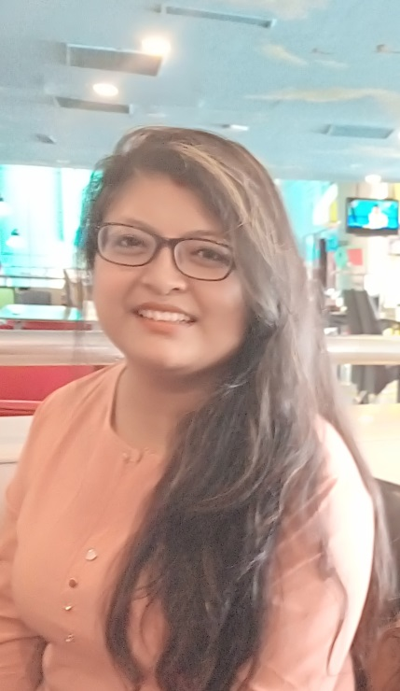
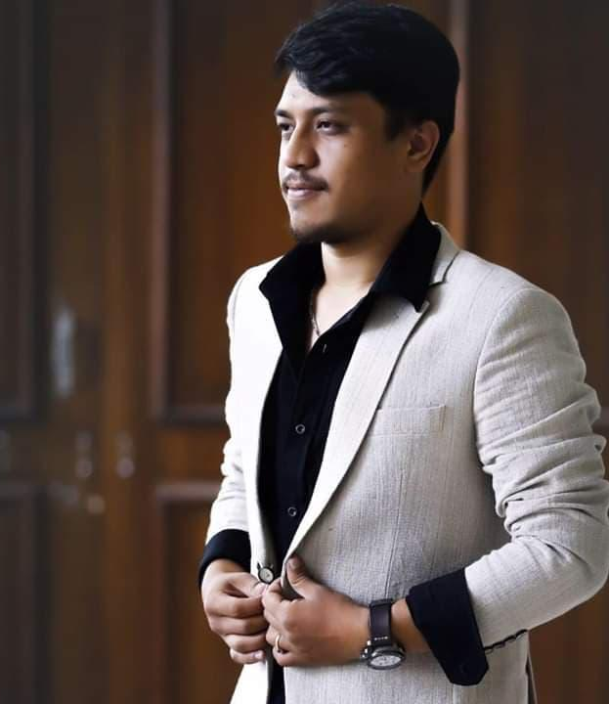
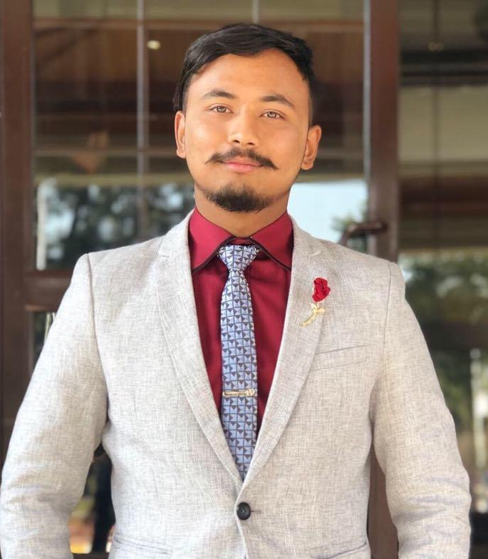
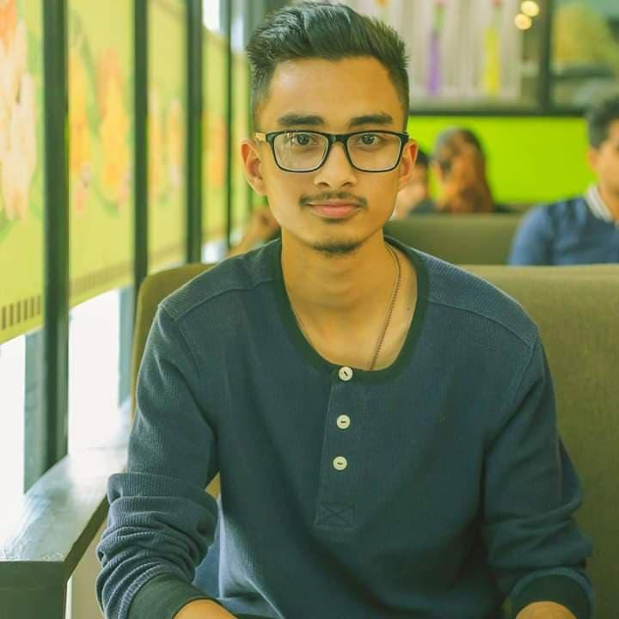
TEAM COMPOSITIONS
Manju Shrestha
CEO
Binju Shrestha
Finance & HR Head
Rabin Shrestha
Managing Director
Binit Joshi
Marketing Manager
Rudum Giri
Coordinator

Slide 4
About Us
Company established in 2064 B.S.
Main Division of the company: -RnR group, event management
-Listing
-KSG, Wedding Solution
A complete service providing organization , provides
complete business solution, business promotion activities
and event management. Primary focus on event management
Established and committed by a young group of some
enthusiastic and working professionals and aims to entertain
people by organizing various programs
12 years of service and over 200 events organization and
management

Slide 5
Our Services
Sales and Promotion
ATL and BTL activation
  Event management
  Brand Promotional Campaign
  Billboards and signage placement
  Print Media
Design and Prints
  Publications (Listing magazine)
  Advertising and Jingles
  Social media campaign
  Graphic Designing
  Web Designing & Hosting
  Printings

Slide 6
Lists of Projects till Date (2064-2076)
Magazine : Listing (since 2009)
Calendar (running): USA Glam Calendar (since 2017)
Social Media Campaign (Facebook): -
Movie Promotion
- Chhakka Panja-2
- Ranveer
Groove Street Entertainment
365 Deals
4. Hob-nob Restaurant

Slide 7
Lists of Projects till Date (2064-2076)
Some Events by RnR Group
USA
  Angels on The Floor, Virginia, USA 2018
  Satya- Sworoop Live Musical Program 2018
  Chhaka Panja 3 Movie Screening in Virginia
  New Years Event, 2019
  Many Charity Shows
Pokhara
Jeevanshaili 2017, 2018, 2019
Golden Jubilee Event of Gandaki Boarding School, 2016

Slide 8
Lists of Projects till Date (2064-2076)
  Kathmandu
REBAN Bandipur Fest 2020
Angels on the Floor VI ,Dhangadhi
Nepal’s Next Supermodel IV, Kathmandu
  Face of Little Flower 2018
  Nepal’s Next Super Model 2018,2017,2016- model Hunt
  Angels on The Floor, Hotel Annapurna 2015/ 2016/ 2017/18
  Concerts (“ Death Metal Band-Decapiated, Poland” at Fun Park Bhrikutimandap, “Rockers Night Out”, “Mukti and Rivival concert”), Save the Planet, Bhrikuti Mandap
  Dance Parties (“Blue light Dance Party”, “Night Out Dance Party”, “Festive Pool Party”, “Weekend Night Out”, “New Year Music Temptation”, “Deck The Halls, X-Mas Party”, “New Year Extravaganza”, “Be Happy, It’s Holi”) 2006 till date
  Holi Festival Party for Star F.M.
  Haat Bazaar for charity
  B-Boying Competition 2013 and 2014
  Live Music Parties (“The Golden Moments”, “Romantic Moments”, “Salute To The Summer”) 2006 till date
Upcoming Events
Angels on the Floor -VII
Nepal’s Next Supermodel

Slide 9
Team building workshops and corporate events
conducted for different organizations:
Team Building workshop
National Trust for Nature Conservation (NTNC),
Central Zoo Staff for 2 days, 2013,2014 & 2015
Staff of Fishtail Lodge Pokhara for 2 days, 2015
Johnson and Johnson Group from India for 1 day
at Gokarna Forest Resort 2016
2 days team building for Agency managers of
Nepal Life Insurance Company, Naxal Branch 2016
E3 Security Solution for 1 day, 2017
Habitat for Humanity at Pokhara 2018
Lumbini Finance 2018
ICTA Certified NPL Coach Practioner for executives
2019
VSO Nepal for 2 days 2019
Corporate Event
Product Launch- Minsk at Hotel
Soaltee and Red Cap at Hotel Yak &
Yeti
Responsible Business Summit
2014, NBI, Hotel Yak and Yeti
Annual Day 2014, GIZ (German
International Cooperation) at NTIC
building
Managed Hotel Himalayan New
Year’s event 2011/12
Annual Day Programme for Star
F.M
Nepal Myanmar Friendship Council,
Tingyan Water Festival
SAARC CCI regional event 2019
Responsible Business Summit
2019, NBI, Hotel Yak and Yeti
(on going)

Slide 10

Portfolio
##
Some pictures of our Past works

Slide 11

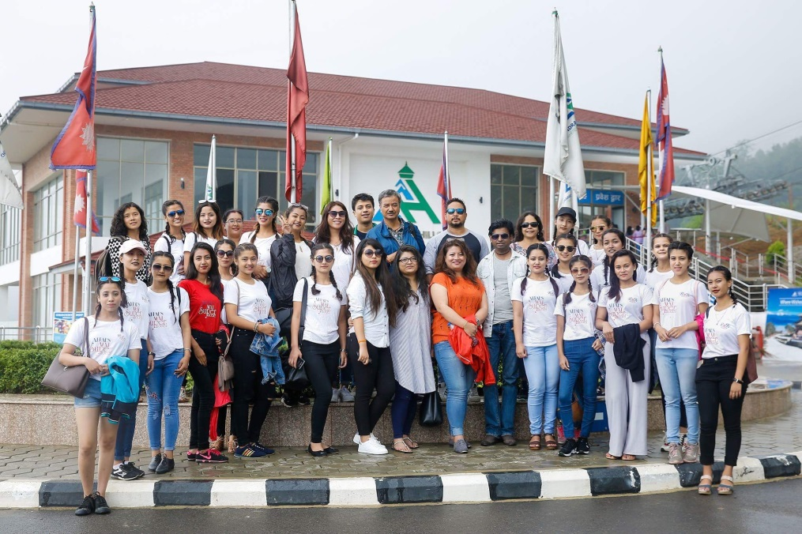
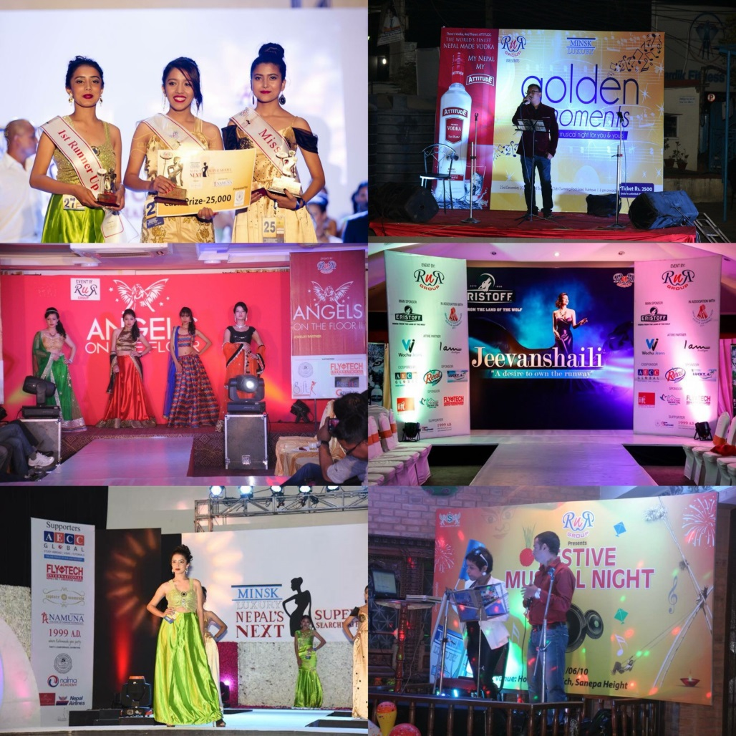
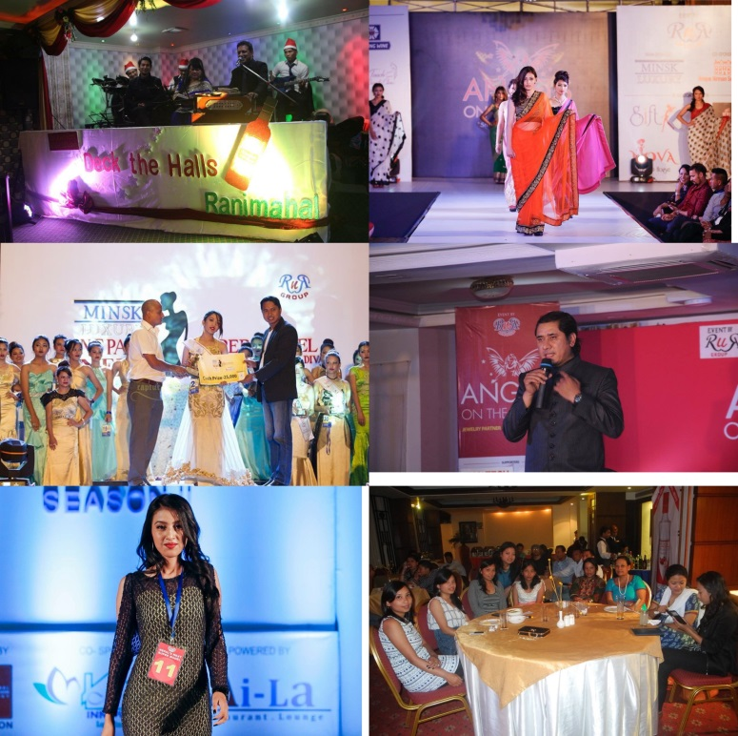
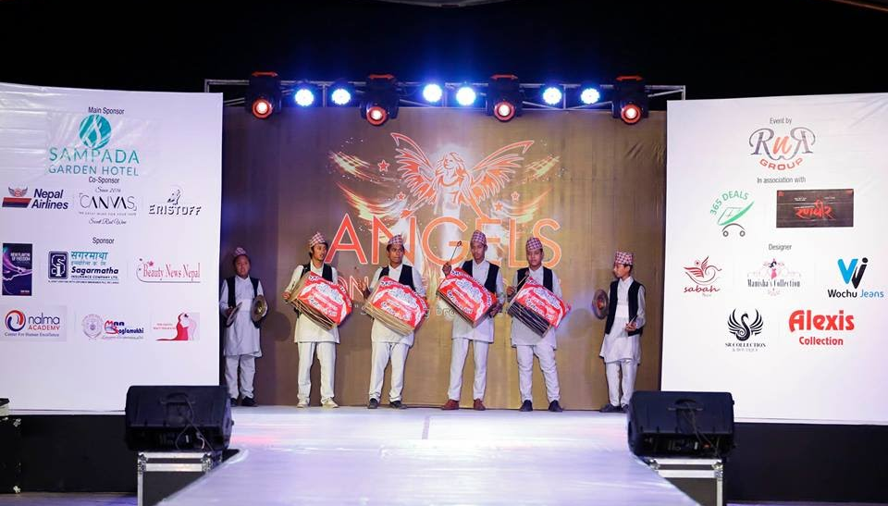
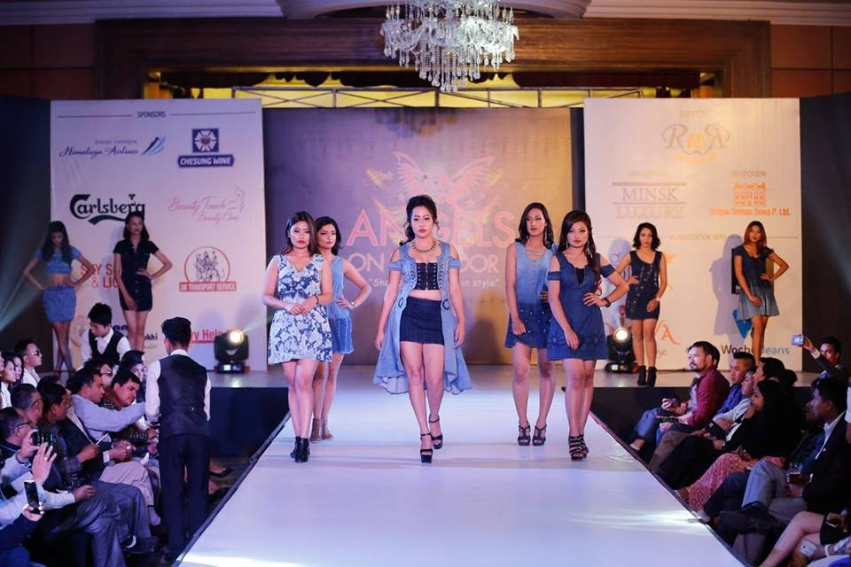
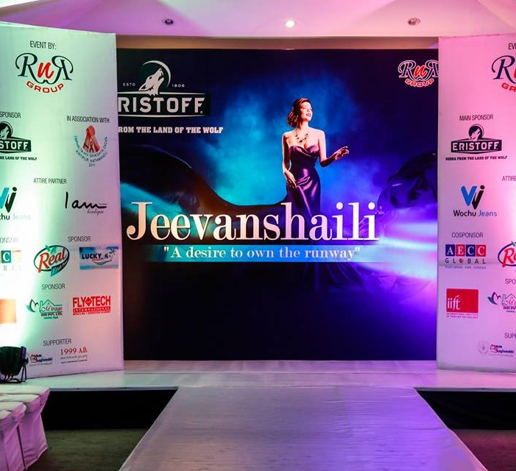
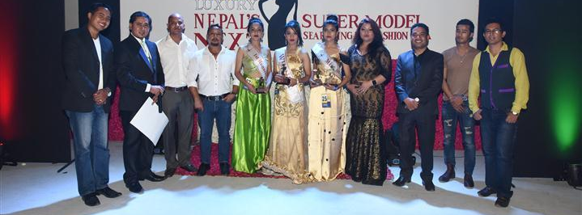

Slide 12
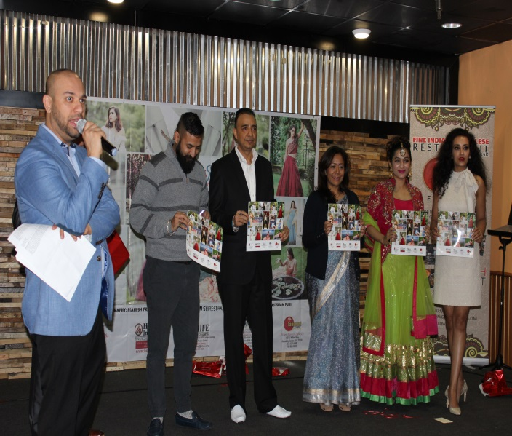
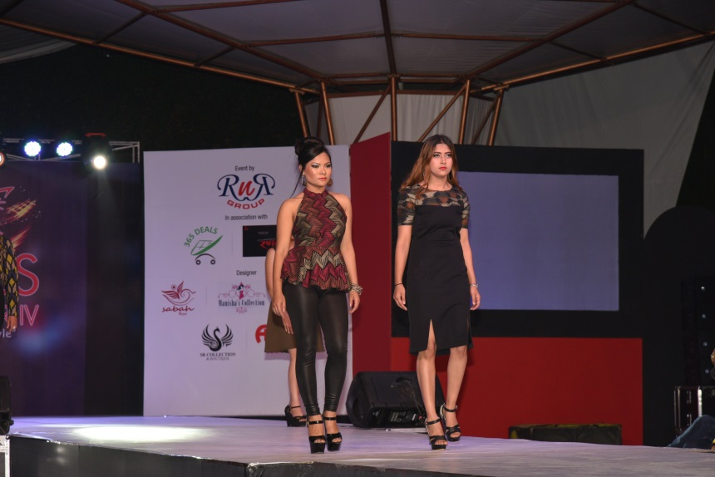

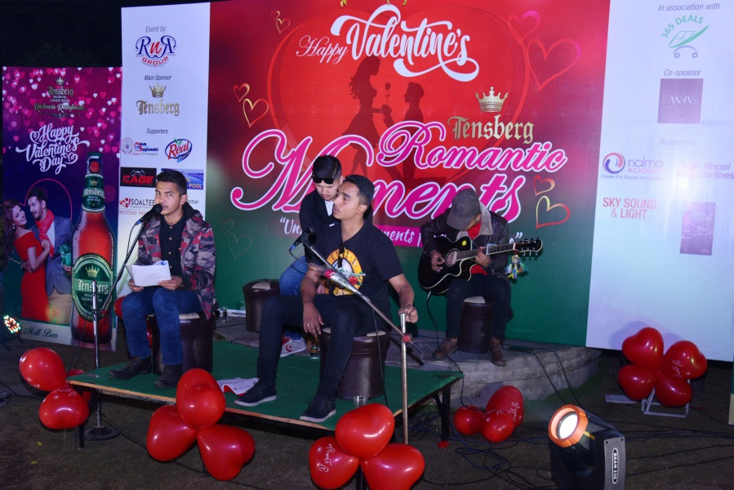
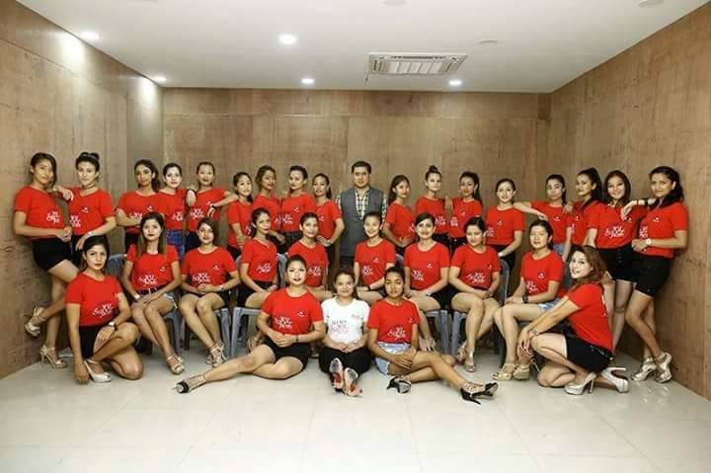
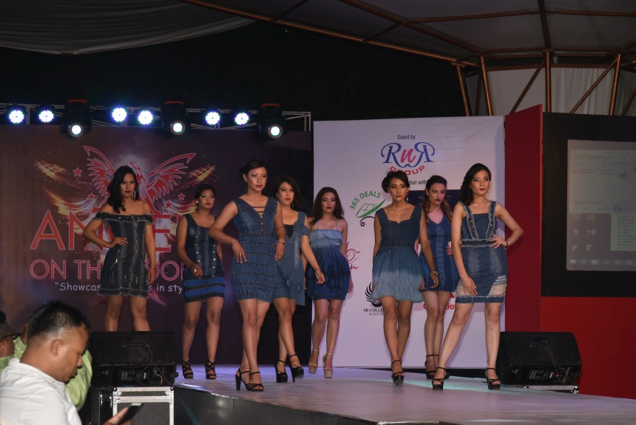
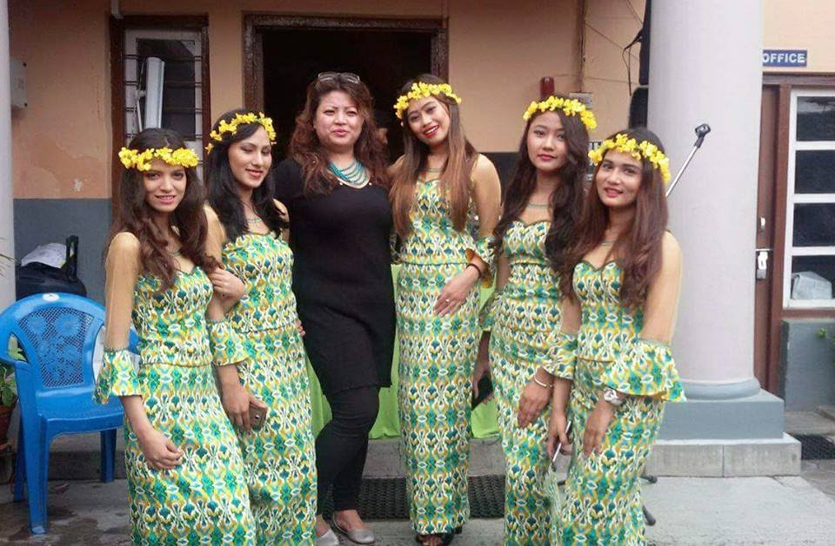
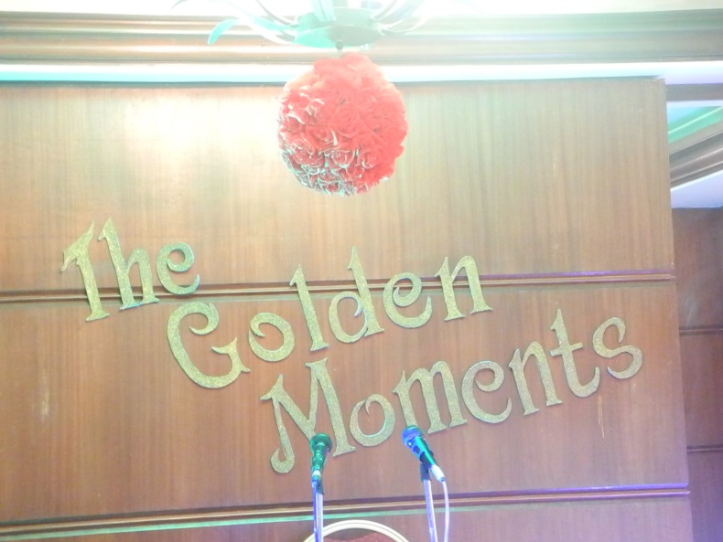
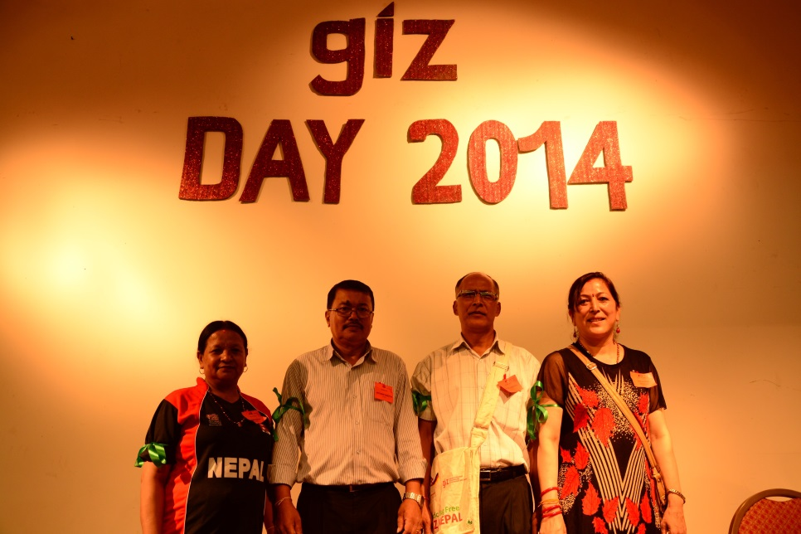
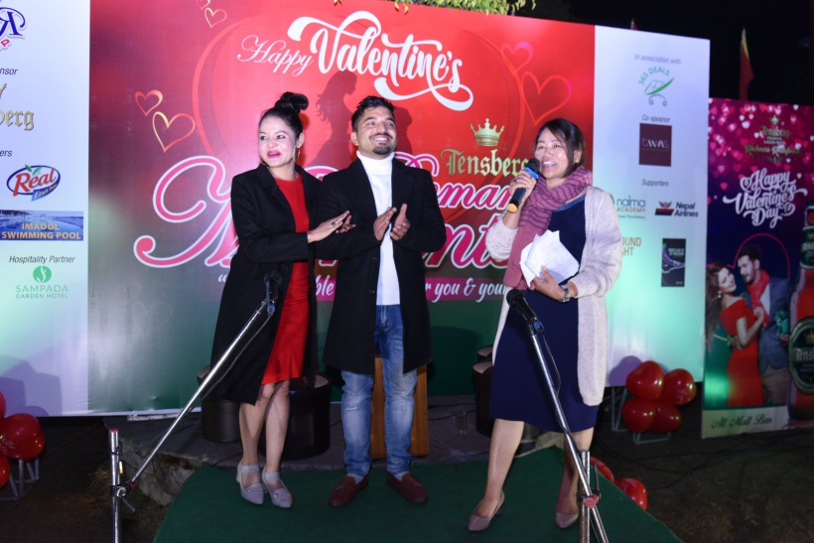


Slide 13

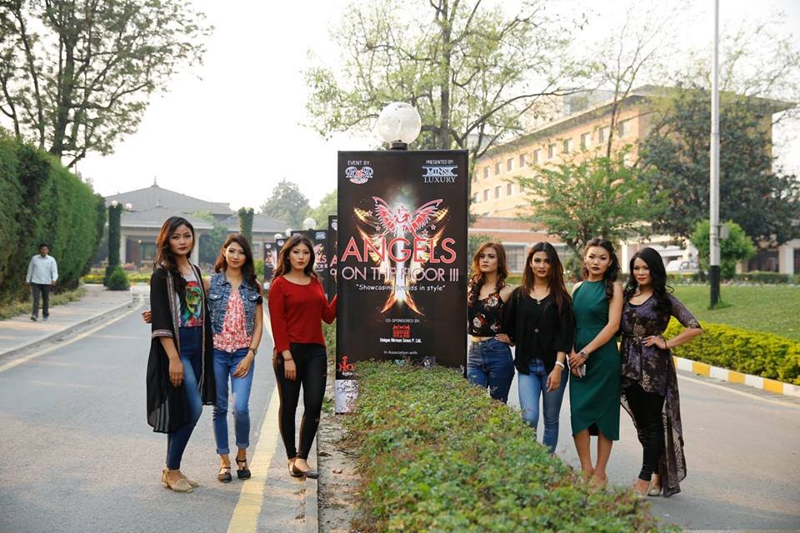
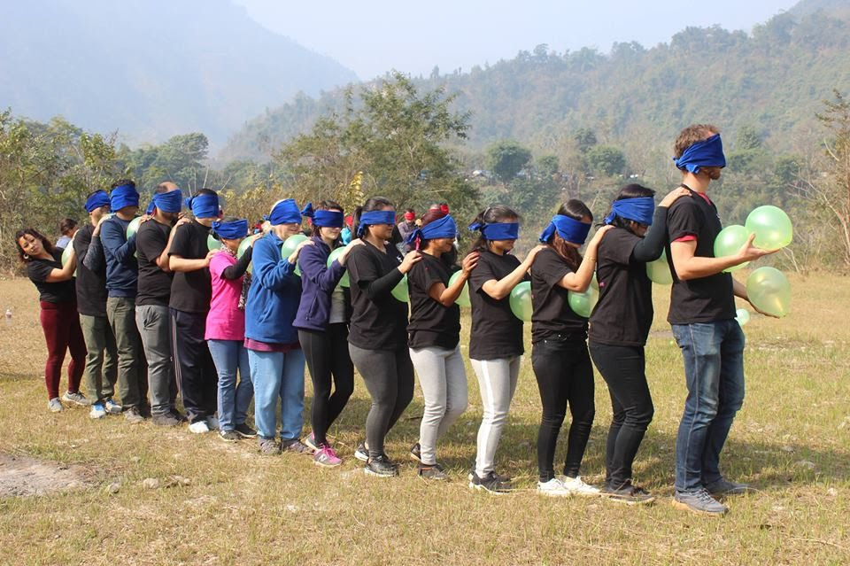
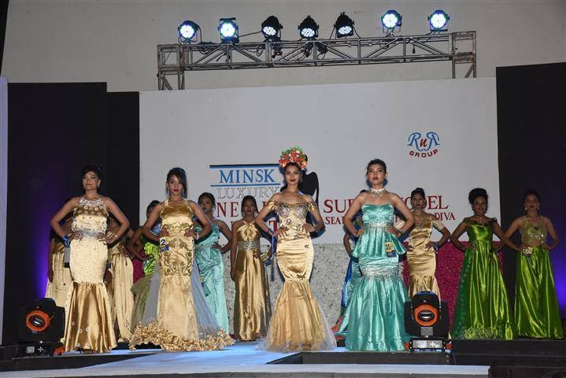
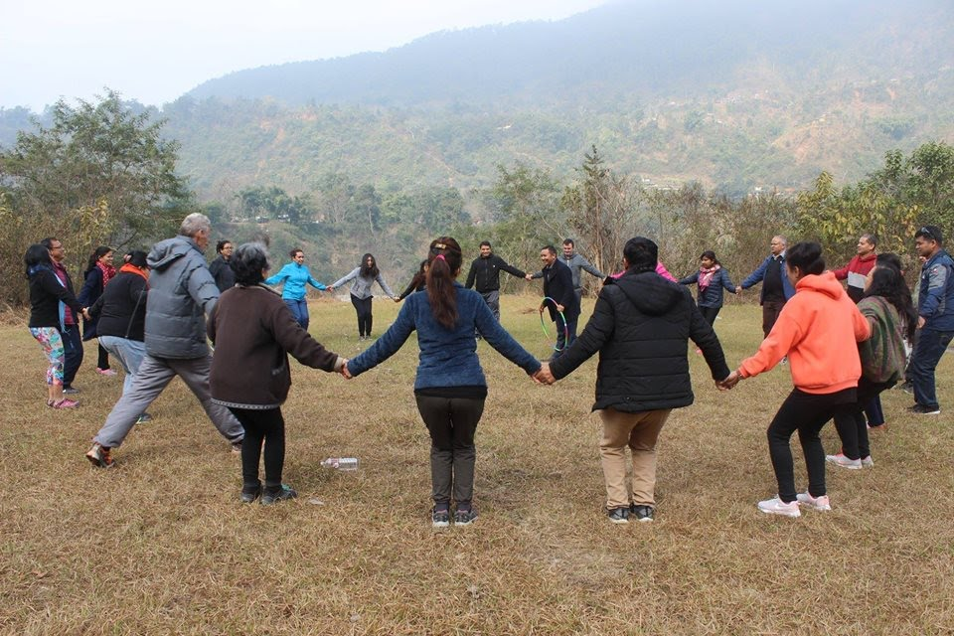
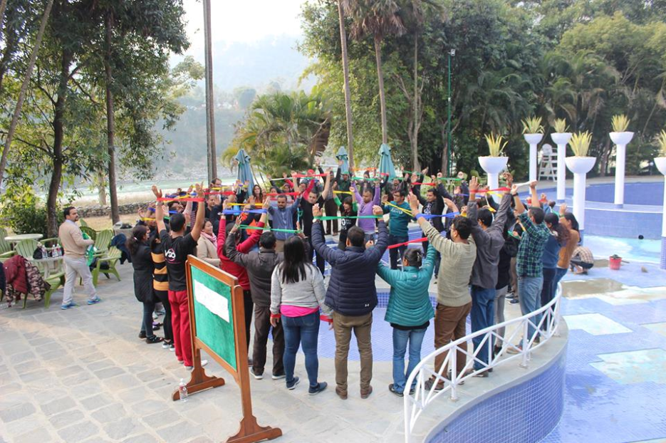
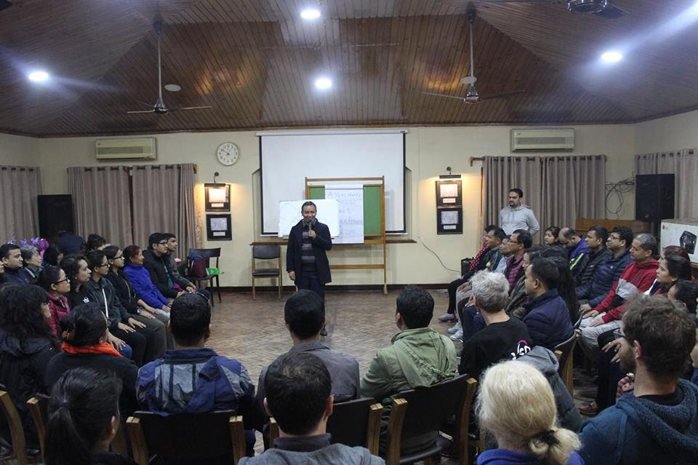
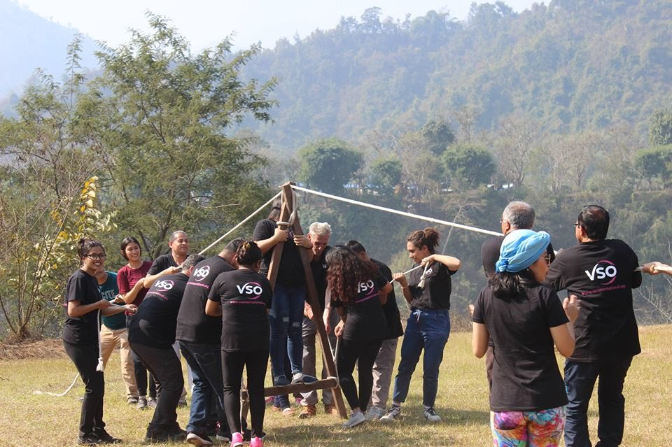

Slide 14

































Some of our supporters throughout our journey

Slide 15





























Slide 16

THANK YOU
For any queries you can find us at 9801008209, 9841228214
solvensolution@gmail.com

